Slide 1

Project Presentation
POORNIMA INSTITUTE OF ENGINEERING & TECHNOLOGY,JAIPUR
DEPARTMENT OF COMPUTER ENGINEERING
Product Backlog And Sprint Backlog Presentation
With DFD And Flow Charts
SESSION 2021-22
Presented By: Guided By:
Dikshant Mali, Pritesh Kumar, Chandan Kumar Name: Mr. Deepak Moud
Reg. no: PIET18CS049, PIET18CS108, PIET18CS040 Designation: Project Head
Year: 4th Year Department: Computer Science

Slide 2
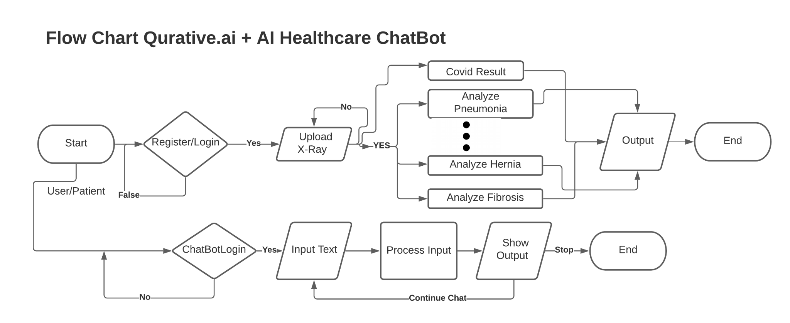
Flow Chart For Qurator.ai

Slide 3
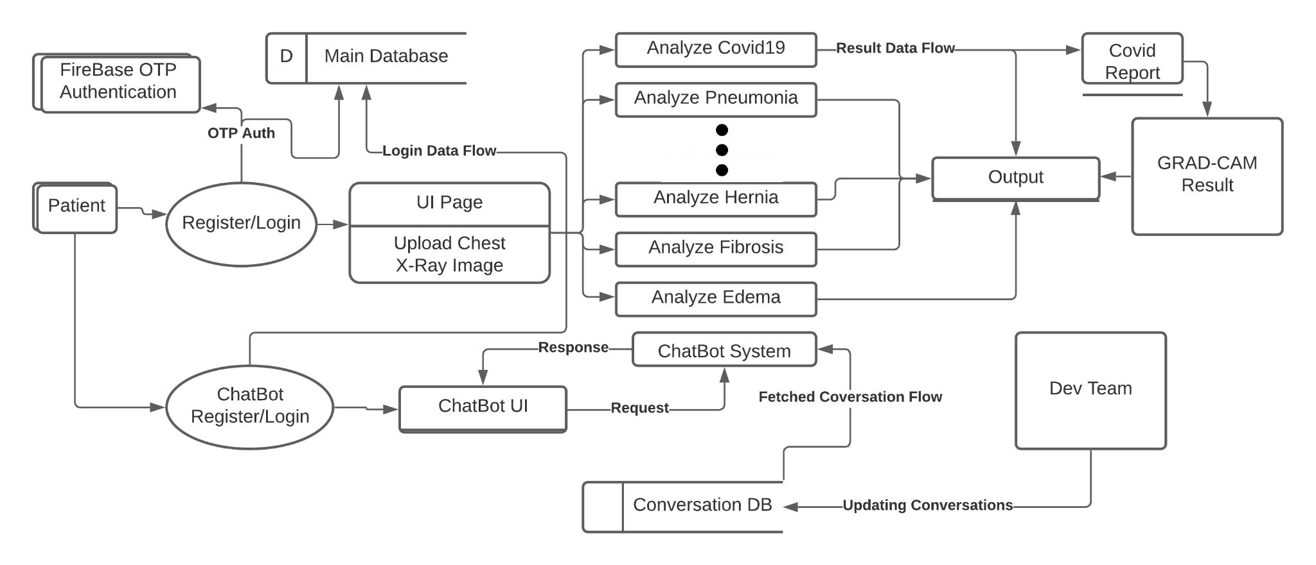
Data Flow Diagram For Qurator.ai

Slide 4
Gantt Chart For Qurator.ai
Show In Product Backlog

